Slide 1

Depth map GENERATION USING MONOCULAR DEPTH ESTIMATION OF DEEP LEARNING
Supervised by
Dr. Pintu Chandra Shill
Professor
Department of Computer Science And
Engineering
Khulna University of Engineering & Technology
Presented by
Dabbrata Das
Roll:1807109
Department of Computer Science And
Engineering
Khulna University of Engineering & Technology

Slide 2
Overview
Introduction
Goals
About Depth Map
Existing and Improvement
Application
Methodology
Model Architecture
Network Architecture
IRv2 Architecture
Result and Discussion
Challenges and Limitations
Conclusion
References
February 24, 2024

Slide 3
Introduction
Depth estimation is one of the most important task in Computer Vision.
Monocular depth estimation means find the depth or distance between two objects from a single RGB image.
Using depth estimation, a depth map will be generated as output for better scene understanding.
Deep learning model is used to implement it.
February 24, 2024

Slide 4
GOALS
The main goal is to generate a more detailed depth map with higher accuracy and compare the result among multiple network architectures.
Then choose the best model to achieve the highest result with less complexity.
February 24, 2024
4

Slide 5

About Depth map
Depth map is an image which contains information about distance among the scene objects from a viewpoint.
Depth Map
Ground Truth
Depth Map
Estimated
Depth Map
February 24, 2024

Slide 6
ABOUT DEPTH MAP
(CONT'D)
GT Depth Map
Used for training the model
Generated by measuring the distance between camera location and the pixel of the image
Provided with dataset and can be used as standard
Estimated Depth Map
Used for application
Generated by trained model
Accuracy is measured compared with GT depth map
February 24, 2024

Slide 7
Existing and Improvement
Existing
Already had CNN based models which provides good accuracy.
Generate depth map from RGB image.
Improvement
Using U-Net with multiple pre-trained models as encoder to improve the accuracy.
Tuning the loss function to get better results.
Generate high detailed depth map of the complex objects.
February 24, 2024

Slide 8
Applications
Autonomous Driving
Augmented Reality
3D Model Reconstruction
Navigation System and Tracking
Medical Imaging
Robotics
February 24, 2024

Slide 9
Methodology
CNN Model
Select U-Net as CNN based model. Some pretrained models are used as an encoder here.
Dataset
Using NYU-Depth v2 dataset which consists of indoor images and GT depth maps.
Trained Model
Basically Model is trained using training set of dataset.
Estimated Map
Finally estimated depth map is generated through trained model
Check Accuracy
Compare the estimated value with GT value to find the loss for improving accuracy.
February 24, 2024

Slide 10
Methodology
(cont'd)
To generate high detailed depth map, different high-performing pretrained models are used with U-Net and among them Inception-Resnet-v2 (IRv2) provides better result.
Tuning the customized loss function to improve the accuracy where adjusting the weights with different values helps to prioritize the different kinds of losses.
February 24, 2024

Slide 11
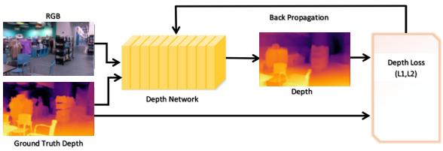
Model ARCHITECTURE
Fig : Overall model architecture for monocular depth estimation
February 24, 2024

Slide 12
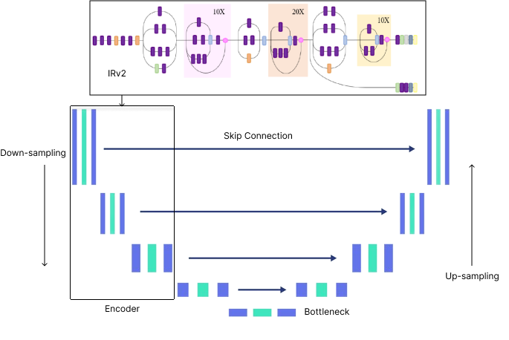
Network ARCHITECTURE
Fig : Network architecture of the model.
February 24, 2024

Slide 13
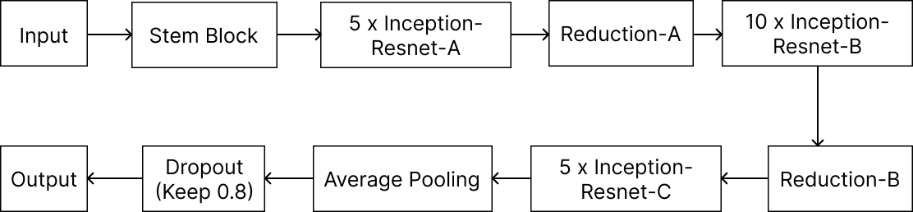
Inception Resnet V2 ARCHITECTURE
Fig : The basic architecture of IRv2 model
February 24, 2024

Slide 14
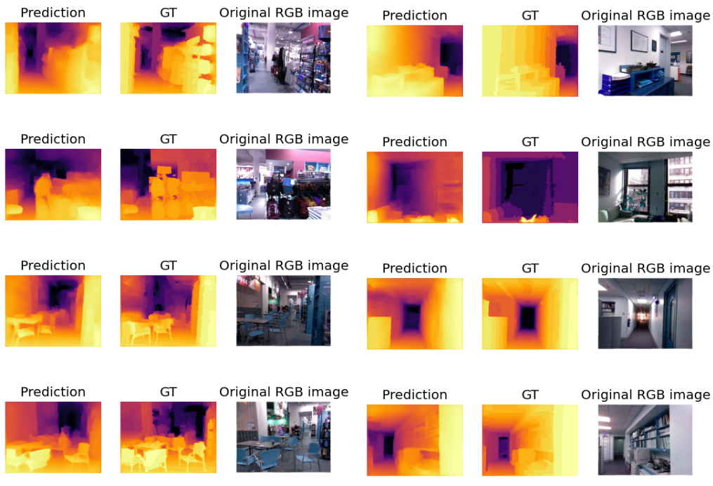
RESULT AND Discussion
Fig : The final output of the model
February 24, 2024

Slide 15
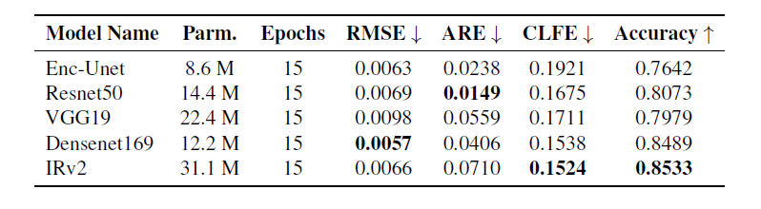
RESULT AND Discussion
(CONT’D)
Table : Evaluation metrics of the model
Upper arrow denotes higer values of the evaluation metrics are better.
Lower arrow denotes lower values of the evaluation metrics are better.
RMSE-Relative Mean Squared Error, ARE-Absolute Relative Error, CLFE-Loss value of Customized Loss Function.
February 24, 2024

Slide 16
Challenges and Limitations
Using a pre-trained model as an encoder, makes the model more complex.
Using larger dataset causes high memory consumption.
Need high-end pc to run the model.
IRv2 has higher number of parameters causes overfitting when the dataset is not large enough.
February 24, 2024

Slide 17
Conclusions
In spite of having some limitations, the main target is to generate more accurate depth map.
Generate depth map with higher resolution and less complexity.
Make the model more flexible.
February 24, 2024

Slide 18
References
R. Ranftl, K. Lasinger, D. Hafner, and V. Koltun, “Towards robust monocular depth estimation: Mixing datasets for zero-shot cross-dataset transfer,” IEEE Transactions on Pattern Analysis and Machine Intelligence, vol. PP, pp. 1–1, Aug. 2020.
C. Szegedy, S. Ioffe, V. Vanhoucke, and A. Alemi, Inception-v4, inception-resnet and the impact of residual connections on learning. arXiv: 1602 . 07261 [cs.CV].
I. Alhashim and P. Wonka, “High quality monocular depth estimation via transfer learning”.
J. Li, R. Klein, A. Yao, A two-streamed network for estimating fifine-scaled depth maps from single rgb images, in Proceedings of the IEEE International Conference on Computer Vision, 2017, pp. 3372–3380.
February 24, 2024

Slide 19
Thank You
February 24, 2024

